Slide 1

ASSIGNMENT 10
Alamouti Coding Scheme
Implementation

Slide 2
Problem Statement
Wireless channels suffer from multipath fading, which degrades signal reliability.
The Challenge:
•
How to achieve Transmit Diversity without increasing bandwidth or requiring feedback from the receiver?
•
Implement and verify the Alamouti Space-Time Block Code (STBC) for 2 Transmit and 1 Receive antenna (2x1).
•
Compare its performance against standard MISO transmission.

Slide 3
Objectives
1. Implementation
2. Analysis
•
Develop MATLAB code for Alamouti STBC.
•
Simulate over a Rayleigh Fading Channel.
•
Implement modulation schemes:
•
Plot Bit Error Rate (BER) vs SNR (0-20 dB).
•
BPSK (Binary Phase Shift Keying)
•
Compare STBC 2x1 performance with standard MISO 2x1.
•
QPSK (Quadrature Phase Shift Keying)

Slide 4
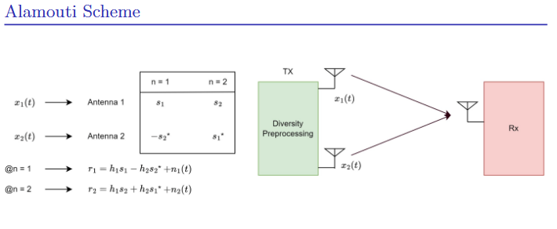
System Architecture: Alamouti 2x1
Space-Time Coding Matrix

Slide 5




Data Flow Diagram (DFD)
(Random Generation)
(Alamouti Matrix Construction)
(Rayleigh Fading + AWGN)

Slide 6
Pseudocode: BPSK Implementation
Initialize N bits
Map bits → BPSK symbols
Split symbols into s1, s2
Form Alamouti matrix S
For each SNR:
Compute noise variance N0
Generate Rayleigh channels h1, h2
Generate noise n1, n2
% ----- STBC Transmission -----
r1 = h1*s1 − h2*conj(s2) + n1
r2 = h1*s2 + h2*conj(s1) + n2
Decode:
s1_hat = (h1*conj(r1) + h2*conj(r2)) / (|h1|² + |h2|²)
s2_hat = (-h2*conj(r1) + h1*conj(r2)) / (|h1|² + |h2|²)
Decide bits and compute BER_STBC
% ----- MISO (2 Tx, no STBC) -----
Generate h1m, h2m
r = (h1m + h2m)*s + n
s_hat = r / (h1m + h2m)
Detect bits and compute BER_MISO
BPSK STBC vs MISO
% 4. Combining Scheme
% 5. Decoding
Explanation
•
Symbol Pair: Takes two symbols (s_1, s_2) at a time.
•
Orthogonality: The received signals r_1 and r_2 are linear combinations of transmitted symbols.
•
Decoupling: By using the channel estimates (h_1, h_2), we can perfectly separate s_1 and s_2 without interference.

Slide 7
Pseudocode: QPSK Implementation
Initialize N bits
Group bits → I,Q → QPSK symbols
Split symbols into s1, s2
Form Alamouti STBC matrix
For each SNR:
Compute noise power N0
Generate channels h1, h2
Generate noise n1, n2
% ----- STBC Transmission -----
r1 = h1*s1 + h2*s2 + n1
r2 = -h1*conj(s2) + h2*conj(s1) + n2
Decode:
s1_hat = (conj(h1)*r1 + h2*conj(r2)) / (|h1|² + |h2|²)
s2_hat = (conj(h2)*r1 - h1*conj(r2)) / (|h1|² + |h2|²)
Recover bits and compute BER_STBC
% ----- MISO (No STBC) -----
Generate h1m, h2m
r = (h1m + h2m)*s + noise
s_hat = r / (h1m + h2m)
Detect I,Q bits
Compute BER_MISO
QPSK STBC vs MISO
% 3. Decoding (Real & Imaginary)
% 4. Bit Reconstruction
Explanation
•
Complex Symbols: QPSK carries 2 bits per symbol (In-phase and Quadrature).
•
Normalization: Power is normalized by sqrt{2}.
•
Detection: Since QPSK uses both real and imaginary axes, threshold detection is applied to both components independently.

Slide 8
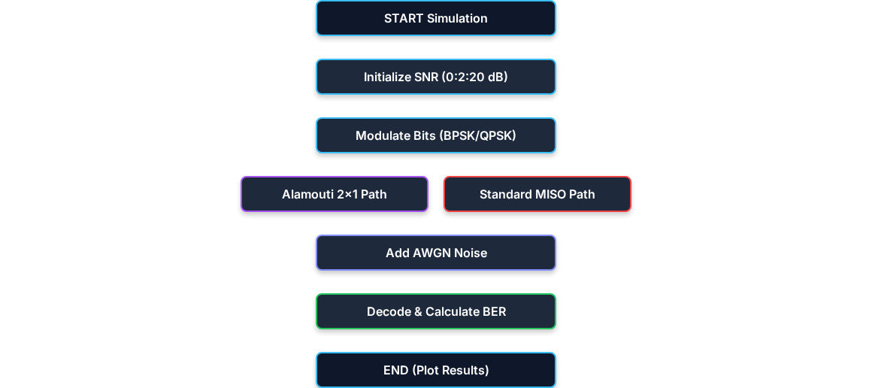
Process Workflow

Slide 9
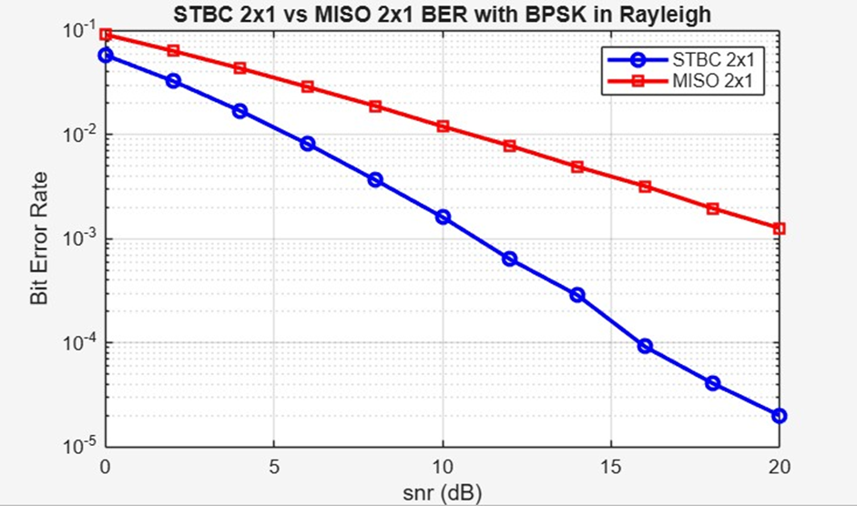
Results: BPSK Performance
Observation
•
STBC 2x1 (Alamouti): Shows significant improvement in BER at higher SNR values compared to the standard MISO channel.
•
The diversity gain effectively steepens the BER slope.
•
At 10dB SNR, BER drops to approx 10^{-3}.

Slide 10
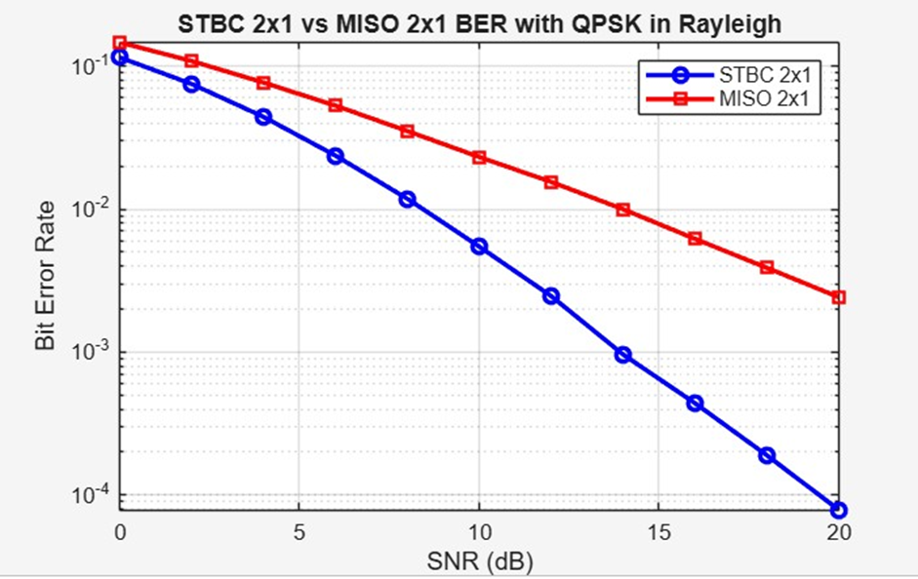
Results: QPSK & Conclusion
QPSK Analysis
•
Similar diversity gain trends observed as BPSK.
•
However, QPSK requires higher SNR (~3dB more) to achieve the same BER as BPSK due to denser constellation.
Conclusion
•
The Alamouti scheme successfully provides full spatial diversity order of 2 for 2 transmit antennas.
•
It mitigates fading effects without bandwidth expansion.

